Slide 1

FOCAL
MENG 570 · PROTOTYPE PRESENTATION · TEAM 5
Three prototypes,
three hypotheses
Which way should Focal help people act on their vision?
Haydn Stucker
Burak Donbekci
Hadley McCormack
Fan Zhang
Qingyi Hu
CEO
CTO
CFO
CCO
CPO
Notes:
TIMING: about 0:10.
Say: We are Focal, Team 5. Today we show three prototypes of one product. Each tests a different hypothesis about how Focal should help people act on their vision. At the end, you vote on the one you would actually use.
FLOW (about 13.5 min): slides 2-3 problem and how our thinking changed (1:30) | slides 4-7 the three versions (about 4:25) | slide 8 live demos (about 1:30 each) | slides 9-11 why we built it this way (about 2 min) | slide 12 the vote.

Slide 2



Convenient or thorough: pick one
THE PROBLEM
2.2 billion
Access is hard
Even a basic check means a clinic visit and a wait.
people live with a vision impairment. At least 1 billion of those cases were preventable or not yet addressed.
Change is hard to see
One snapshot can't show a trend, and kids memorize home charts.
Early detection needs routine checks. Routine checks are hard to get.
WHO WE'RE BUILDING FOR
Online tests aren't trusted
Adults putting off routine eye checks (Riley) · parents of young kids (Pat) · first-time license applicants (Alex)
No credible source behind them, and a number with no next step.
Source: WHO, World report on vision (2019)
Notes:
TIMING: about 0:40 (slides 2 and 3 together are the problem section, about 1:30; the assignment allows 2:00).
WHO WE'RE BUILDING FOR: three personas from our Define work: Riley (adult who wears corrective lenses and puts off routine checks), Pat (parent of a young child), Alex (first-time license applicant). A fourth persona, the licensing supervisor, only appeared in virtual interviews, so no prototype targets it.
Early detection needs routine checks, and routine checks are hard to get. Today people choose between convenient (an online chart) and thorough (a clinic exam). We heard three pains: access, seeing change over time, and trusting an online result.
SOURCE: WHO, World report on vision (2019); Blindness and vision impairment fact sheet.

Slide 3

What we knew then vs. now
HOW OUR THINKING CHANGED
When we started
After 10 interviews
Problem: vision testing is hard to access and outdated
People need a more accurate test
Big institutional buyers: DMVs, airlines, pilots
Avoidance isn't only logistics: “maybe I'm fine” feels safer
Urgency comes from outside: a prescription, a school letter, a DMV date
Trust and a clear next step matter, not just accuracy
Pilots dropped. Licensing agencies stay a hypothesis
10 interviews · 4 personas · 5 in person, 5 virtual (AI-simulated personas). A small convenience sample: it gives us hypotheses to test, not validated demand.
Notes:
TIMING: about 0:45. Finish the problem section by 1:30.
We started thinking the problem was access, and that institutions like DMVs and airlines were the big market. Ten interviews moved us. People avoid the answer, not just the appointment. Action needs an outside trigger. And a result only helps if people trust it and know what to do next. We dropped pilots because no interview supported them. Licensing agencies stay a hypothesis because we only reached that persona through AI-simulated interviews.
BE HONEST ABOUT THE EVIDENCE: five virtual (AI-simulated personas) and five in person. The parent finding (kids memorize a home chart; one parent already kept exam records) is from a real interview. Alex's DMV scenario and the licensing supervisor are virtual-persona evidence, so C's DMV deadline is a bet to test with real applicants.
SOURCES: docs/research/customer-discovery/presentation.pptx; interview-workbook.docx (sections 3B, 3C and the Team Final Assessment); docs/strategy/lean-canvas.pptx.

Slide 4
Same job, three ways to help
OUR EXPERIMENT
Every version serves one job: “Has my vision changed, and do I need to see an eye doctor?” They differ in how much Focal judges for you. What we want to learn: how much judgment do people actually want?
Less judgment
More judgment
B
PARENT PAT
A
RILEY
C
ALEX
Focal Family
Focal Monitor
DMV Pre-Check
The parent decides what it means. No score at all.
You read the trend. Focal shows the change.
Focal gives a verdict against a real rule.
Notes:
TIMING: about 0:25.
One job sits under all three versions: has my vision changed, and do I need a doctor? We built three answers that differ in how much the product judges for you. B leaves the judgment with the parent: no score at all. A shows a trend and lets you read it. C gives a verdict against an official rule. The vote tells us which degree of judgment people actually want.
(The cards are ordered along the spectrum, not alphabetically, on purpose.)

Slide 5
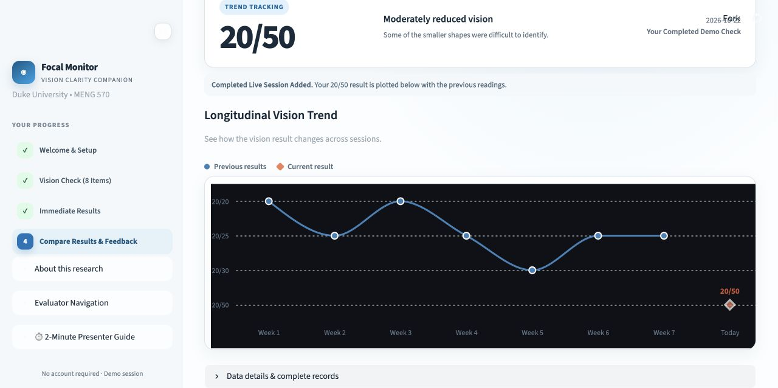
Focal Monitor
PROTOTYPE A · ROUTINE-CHECK RILEY
Trigger: a prescription about to expire · Built by Qingyi and Fan
A
HYPOTHESIS
Adults concerned about changes in their vision will find ongoing tracking more useful than a single test result.
THE CORE FLOW
1
An eight-letter tumbling-E check
Trend view on the public demo. The history is illustrative, not real data.
2
Today's result, shown on its own
WHAT WE HEARD
“There's no baseline to compare against.” Riley, virtual interview
3
The same result on a seven-week trend (illustrative history)
4
Neutral feedback: which view helped?
PROPOSED SUCCESS SIGNAL At least 3 of 5 Riley-like testers state a format preference and explain why.
WHAT WOULD CHALLENGE IT
A flat preference, mixing up the illustrative history with today's result, or a preference for the single result.
Notes:
TIMING: about 1:20. With the framing on slide 4, each hypothesis takes about 1:30 to 2:00.
Riley wears corrective lenses and wants to understand change between exams. The bet: seeing change over time is worth more than one score. The prototype runs an eight-item check, then shows the SAME result two ways, alone and on a seven-week trend, in random order, then asks neutral questions.
LIMITS TO SAY OUT LOUD: the seven weeks of history are fictional and labeled as such, and the acuity-style labels (20/20 to 20/200) are illustrative, not calibrated. This tests stated preference, not whether people really come back.
PROPOSED SIGNAL (a decision aid, not a finding): at least 3 of 5 Riley-like participants state a format preference and explain why. WOULD CHALLENGE THE BET: a flat preference, confusion between fictional and current data, or a preference for the single result.
SOURCES: prototypes/prototype-a-riley-vision-tracking/README.md (Feature Scope Card); https://focal-demo-a.streamlit.app/ (screenshot captured Oct 21, 2026).
QUOTE ON SLIDE: "There's no baseline to compare against." (Riley, virtual interview). Virtual interviews were AI-simulated personas; we checked the wording against interview-workbook.docx, and in-person interviews backed the same themes.

Slide 6
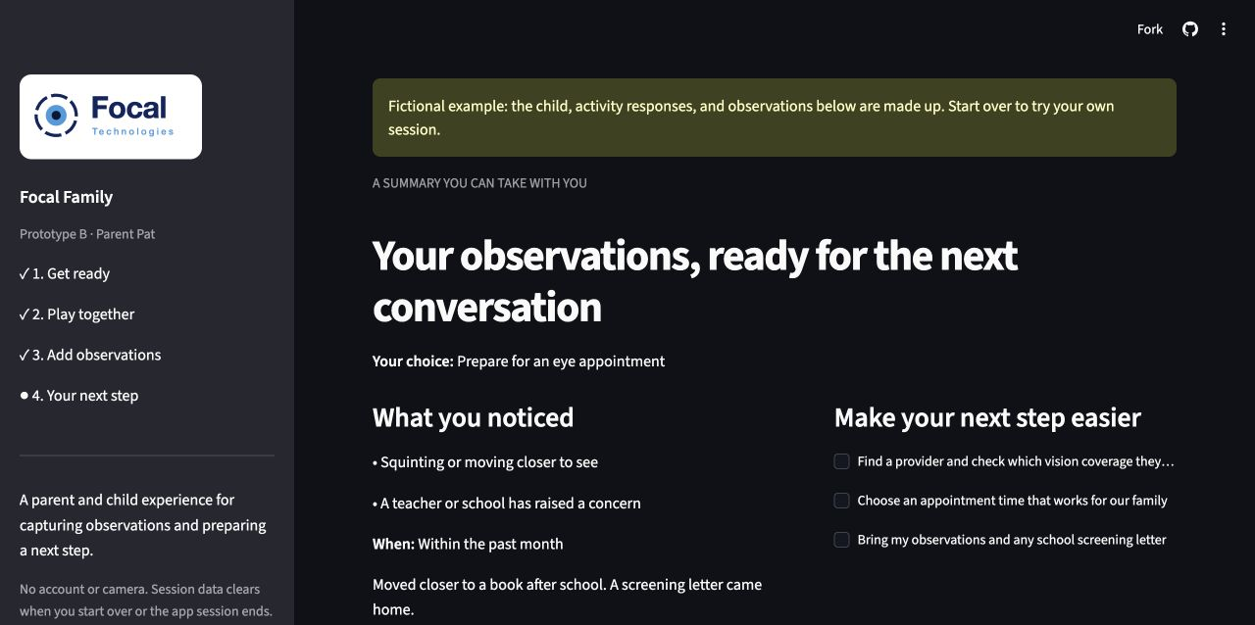
Focal Family
PROTOTYPE B · PARENT PAT
Trigger: a school screening letter · Built by Haydn
B
HYPOTHESIS
Parents will finish a short picture game with their child, then use what they noticed to pick a concrete next step.
THE CORE FLOW
1
Practice, then six large matching pictures
Summary screen, using the built-in fictional example (labeled in the app).
2
The parent notes what they've noticed
WHAT WE HEARD
“I want to know when there is a reasonable reason to get it checked.” Pat, virtual interview
3
The parent picks a next step and prepares questions
4
A summary to bring along. No score, by design.
PROPOSED SUCCESS SIGNAL At least 4 of 5 parents finish unaided; at least 3 of 5 choose appointment or school-contact preparation.
WHAT WOULD CHALLENGE IT
Parents find the game irrelevant or the summary unhelpful. A download click shows a request, not follow-through.
Notes:
TIMING: about 1:20.
Pat is a working parent who relies on school screenings. Kids can't explain what they see, and they memorize home charts. So B does not measure anything. A parent and child play a short matching game together (shapes, not letters), the parent records what they've noticed, and Focal helps them prepare a concrete next step. The bet: parents value preparation and support over a number.
The app never infers a care recommendation from how many pictures matched. Pictures are always large; there is no timer or pass mark; the child can skip or take a break.
PROPOSED SIGNALS (small-sample decision rules, not findings): 4 of 5 parents finish unaided; 3 of 5 choose appointment or school-contact preparation. WOULD CHALLENGE THE BET: parents find the activity irrelevant or the note unhelpful. Expressed intent or a download is not proof an appointment happened.
SOURCES: prototypes/prototype-b-parent-guided-check/README.md; customer discovery workbook (one real parent kept detailed exam records and described a child memorizing a home chart); https://focal-demo-b.streamlit.app/ (screenshot of the built-in fictional example, Oct 21, 2026).
QUOTE ON SLIDE: "I want to know when there is a reasonable reason to get it checked." (Pat, virtual interview). Virtual interviews were AI-simulated personas; we checked the wording against interview-workbook.docx, and in-person interviews backed the same themes.

Slide 7
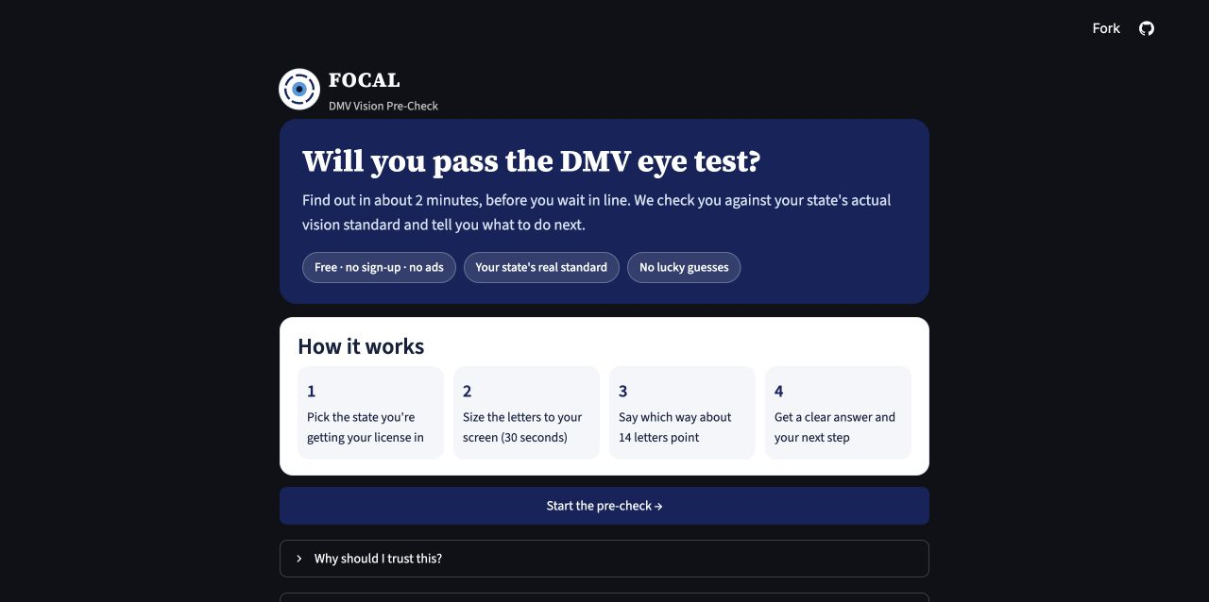
DMV Pre-Check
PROTOTYPE C · ANXIOUS APPLICANT ALEX
Trigger: a DMV vision screening coming up · Built by Burak
C
HYPOTHESIS
People with a DMV vision screening coming up will prefer, and act on, a check that answers “Will I pass my state's test?” with a clear next step.
THE CORE FLOW
1
Pick your state and see its real rule
Welcome page on the public demo.
2
Size the letters to your screen with any ID card
WHAT WE HEARD
“I didn't even know if that's a pass or a fail.” Alex, virtual interview
3
Read 14 letters, six at the line that decides
4
Get a verdict and a next-step plan
PROPOSED SUCCESS SIGNAL 60% would likely use it before a DMV visit; 70% knew if they would pass; 50% told to see a doctor would book first.
WHAT WOULD CHALLENGE IT
Our riskiest assumption: a DMV visit isn't enough of a trigger. Alex said the road test worried him more than the vision screening.
Notes:
TIMING: about 1:20.
Alex is a college student getting a first license. He doesn't want a number; he wants to know whether he will pass his state's test. C checks against the real rule for NC, CA, NY, TX and FL, each with an official source (checked October 2026), and falls back to "another state". Letters are sized to the screen using any ID card. Six letters sit at the deciding 20/40 line, so a lucky guess can't pass you, and "Can't tell" is always available. You get one honest retake, shown side by side. If it's not a pass, you get a plan: an eye exam near you, your state's form, a simulated reminder, and a draft message for a parent. This is also the free DMV checker from our Lean Canvas channels.
PROPOSED SIGNALS (not findings): 60% of people with a DMV visit coming say they'd likely use it; 70% say they knew whether they'd pass; 50% told to see an eye doctor first say they'd book before the DMV. RISKIEST ASSUMPTION: a DMV visit may not be a strong enough trigger (Alex: "more of a background worry").
LIMITS: both eyes together only (CA and TX also test each eye); not an official DMV test or a clinical prediction.
SOURCES: prototypes/prototype-c-alex-dmv-precheck/README.md; https://focal-demo-c.streamlit.app/ (screenshot, Oct 21, 2026).
QUOTE ON SLIDE: "I didn't even know if that's a pass or a fail." (Alex, virtual interview). Virtual interviews were AI-simulated personas; we checked the wording against interview-workbook.docx, and in-person interviews backed the same themes.

Slide 8
See it work
LIVE DEMO
A
Focal Monitor
B
Focal Family
C
DMV Pre-Check
focal-demo-a.streamlit.app
focal-demo-b.streamlit.app
focal-demo-c.streamlit.app
Eight responses
Same result, two views
Preference and reason
Practice and six pictures
Observations and next step
The take-home summary
State, rule and ID-card sizing
Letters, with “Can't tell”
Verdict and action plan
Open all three tabs before class: idle Streamlit apps go to sleep, and a cold start can take up to 20 seconds.
Notes:
TIMING: aim for about 1:30 per prototype (about 4:30 total); the assignment allows about 2:00. The minute marks below are for a full 2:00 run: if you're running long, drop the last step of each demo. Let each product speak; do not narrate every click. If a live app fails, say so, show the matching screenshot on the version slide, and move on.
BEFORE CLASS: open all three links in the browser you will present from, at least 5 minutes ahead (idle Streamlit apps sleep; first loads took 10-20 seconds when we checked on Oct 21). Run each main journey once in a fresh session. Keep one finished-result tab per prototype as a backup.
A (Focal Monitor): 0:00-0:20 open and introduce Riley. 0:20-0:55 answer the eight Es. 0:55-1:30 open Compare Results and switch between Single Result and Trend Tracking; point out the history is illustrative and today's point is separate. 1:30-2:00 show the neutral feedback and the Reset button. Do not call the 20/xx label a measurement. HEADS-UP: A's answer buttons follow the browser's color theme; in a dark-theme browser their labels were hard to read when we tested. Present from a light-theme browser (or fix the button CSS in app.py) and check before class.
B (Focal Family): 0:00-0:20 pick a child label and age group, do the practice circle. 0:20-0:55 play the pictures, skip one, try Take a break. 0:55-1:30 record an observation, choose a next step, add a question. 1:30-2:00 show the summary and feedback. Nothing is booked or sent. The built-in "Explore a fictional example" is a labeled backup, not a participant result.
C (DMV Pre-Check): 0:00-0:30 North Carolina is the default: show the rule card and its source link, hold an ID card to the sizing box, tick the three setup boxes. 0:30-1:15 answer the first lines, then tap "Can't tell" on a few letters at the 20/40 line (the check can end early). 1:15-2:00 show the verdict, the next-step plan, the simulated reminder and the Retake option. Don't force a favorable outcome.
LINKS: A https://focal-demo-a.streamlit.app/ | B https://focal-demo-b.streamlit.app/ | C https://focal-demo-c.streamlit.app/

Slide 9
Scoped to one decision each
PRIORITIZATION · FEATURE SCOPE CARD
Version | Core feature | Value | Effort | Complexity | Proposed success signal
A · Monitor | One result in two formats | High | Medium | Medium | 3 of 5 explain a format preference after viewing both
B · Family | Parent observations and next-step preparation | High | Low to medium | Low to medium | 4 of 5 finish unaided; 3 of 5 choose appointment or school-contact preparation
C · Pre-Check | Deadline-specific check and action plan | High | Medium | Medium | 70% understand the result; 60% would use it before a DMV visit
Estimates apply to the scoped core flows. The success signals are proposed pilot targets for small samples, not findings.
Each prototype's README holds its full Feature Scope Card.
Notes:
TIMING: about 0:40.
Prioritization used the same lens from the in-class Feature Scope Card: value, effort, complexity and a success signal. Each prototype tests exactly one decision, and the effort went where a fair test needed it: A's medium effort protects a fair format comparison; B keeps observation capture simple and spends extra effort on note editing and pause/resume; C spends effort on state rules, sizing and how the result is communicated. All three keep feedback visible because the goal is learning.
CAVEAT: effort and complexity are qualitative team estimates synthesized from the per-prototype scope cards. The numeric signals are proposed pilot rules, not statistically powered thresholds, and they do not make the three personas directly comparable.
SOURCES: README.md scope cards in prototypes/prototype-a..., prototype-b..., prototype-c...

Slide 10

What we kept, what we cut
PRIORITIZATION
Version | Tests one thing | Cut on purpose | Right call?
A · Monitor | Single result vs. trend | Real history, accounts, persistent data | Yes for preference. It can't show return visits.
B · Family | Observations → next step | Any score, camera, provider search | Yes. Open question: do parents want a number?
C · Pre-Check | Verdict vs. a general score | Per-eye testing, 45 states, agency view | Mostly. Per-eye testing matters in CA and TX.
Our biggest cut: no prototype for licensing agencies. The licensing supervisor's needs come only from AI-simulated interviews, so we test consumers first.
All three are non-clinical practice prototypes with no accounts, stored data or real booking. Our evidence: 10 interviews, half AI-simulated.
Notes:
TIMING: about 0:45.
Each prototype tests exactly one decision, and we cut everything that didn't serve it. The cost of each cut: A cannot show real retention (the history is illustrative); B has no score on purpose, so the open question is whether parents want one, and it cannot show that an appointment happened; C tests both eyes together across five states, which is mostly right, but California and Texas also check each eye, and it cannot claim official acceptance. Our biggest cut was the agency side, because that evidence is thinnest. Adding every integration now would raise effort and muddy the comparison. Clinical calibration and validation are separate work for all three.
SOURCES: scope cards and "Deliberate cuts" sections in each prototype README.

Slide 11
What three versions tell us
STRATEGY
1
Trust and a next step are the product
Every version ends in a concrete next step, not a bare score.
2
Real-world triggers bring people in
Each version hooks onto a moment that already forces action: a prescription, a school letter, a DMV date.
3
One check, different front doors
The check itself can be shared; the persona decides how the result is framed.
DIRECTION Build the shared check once; let the class vote and pilot feedback choose the front door.
Notes:
TIMING: about 0:40.
What building three versions taught us. First, the hard part isn't the test, it's trust and action, so every version ends in a next step. Second, people act when something forces it: a prescription, a school letter, a DMV date. Each version attaches to one of those moments. Third, the underlying check could be shared; what changes is the front door and how the result is framed.
Close by pointing to the vote: which front door people pick tells us which direction to build first.

Slide 12



Which one would you actually use?
YOUR TURN
A
Focal Monitor
B
Focal Family
C
DMV Pre-Check
A result in the context of change over time
A shared activity and a prepared parent conversation
A practice result before a specific deadline
focal-demo-a.streamlit.app
focal-demo-b.streamlit.app
focal-demo-c.streamlit.app
Notes:
TIMING: about 0:45, plus the vote itself.
Before the vote, say one sentence: the vote is data, not a verdict. The room is mostly students, closer to Riley and Alex than to Pat, so a low B vote may say more about the room than about parents. A favorable vote tells us which direction to investigate next, not proven demand.
Leave this slide up during the vote. Ask the class to vote for the prototype they would actually use and to give a reason. The QR codes open each prototype on a phone, so people can try one while they decide. Thank the class. After the results, record the tally and the team's response in docs/assignment-readiness.md.

Slide 13
Links, repo and build log
BACKUP · OUTSIDE THE MAIN TALK
Prototype A · Focal Monitor
focal-demo-a.streamlit.app
Prototype B · Focal Family
focal-demo-b.streamlit.app
Prototype C · DMV Pre-Check
focal-demo-c.streamlit.app
Repository
github.com/haydn-s/focal-technologies
Team prompt log
github.com/haydn-s/focal-technologies/blob/main/prompts.md
Built with AI coding assistants; the prompt log (A1–A5, B1–B5, C1–C6) records each AI-assisted step. Each prototype's README holds its hypothesis, Feature Scope Card and deliberate cuts.
Notes:
Backup slide, not part of the timed talk. Use it for Q&A: it has the three public links, the repository, and the shared prompt log (at least five prompts per prototype, as the assignment requires).
STATUS TO CONFIRM BEFORE CLASS (see docs/assignment-readiness.md): two human rehearsals per demo, a final public full-flow check, and the Canvas submission are not yet recorded.

